Slide 1

Formulate Engineering Problems to Optimization Problems
Professor Bo Liu
James Watt School of Engineering

Slide 2
Procedures to formulate an optimization problem
  Step 1: Identify the requirements.
  Step 2: Classify the requirements to objectives and constraints.
  Step 3: Identify the decision variables and their properties.
  Step 4: Identify the search space.
  Step 5: Identify if there is a starting point.
  Step 6: Identify how to obtain the objective and constraint function values.

Slide 3
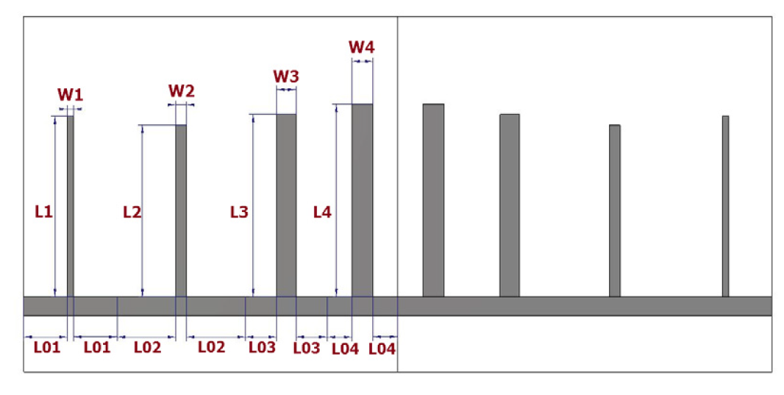
A case study
  Problem: Design an 8th order microstrip filter. The operating frequency is 3.3 GHz to 7.3 GHz. The designer comes to you for consultancy.

Slide 4
Procedures to formulate an optimization problem
  Step 1: Identify the requirements.
  Consultant: What are the design requirements?
  Designer: Passband: 4 GHz to 7 GHz, two stopbands: one is from 3.3 GHz to 3.92 GHz, the other one is from 7.08 GHz to 7.3 GHz.
  Consultant: Could you please detail the requirements?
  Designer: Passband max(|S11|) $≤$-20 dB for passband, min(|S11|) $≥$ -3 dB for stopbands. ​

Slide 5
Example explanation
  Step 1: Identify the requirements.
Consultant: Could you please write your requirements as constraints? For constraints, I mean ...
Designer: Passband: max(|S₁₁|)$≤$-20 dB,
Stopband: min(|S₁₁|) $≥$-3dB
Consultant: Great. I got it.

Slide 6
Example explanation
  Step 2: Classify the requirements to objectives and constraints.
  Consultant: For these requirements, are there objectives? For objectives, I mean, …
  Designer: Yes, for the passband requirement, the smaller the better. For the stopband, meeting the spec is fine.
  Consultant: Your problem has one objective and two constraints. It is a single objective constrained optimization problem.

Slide 7
Example explanation
  Step 3: Identify the decision variables and their properties.
  Consultant: What can be controlled in your problem? We call them the design variables. Let me explain.
  Designer: There are 12 design variables, which are the geometric parameters, as I have shown in the figure.
  Consultant: OK. Now, I got your decision variables to optimize.

Slide 8
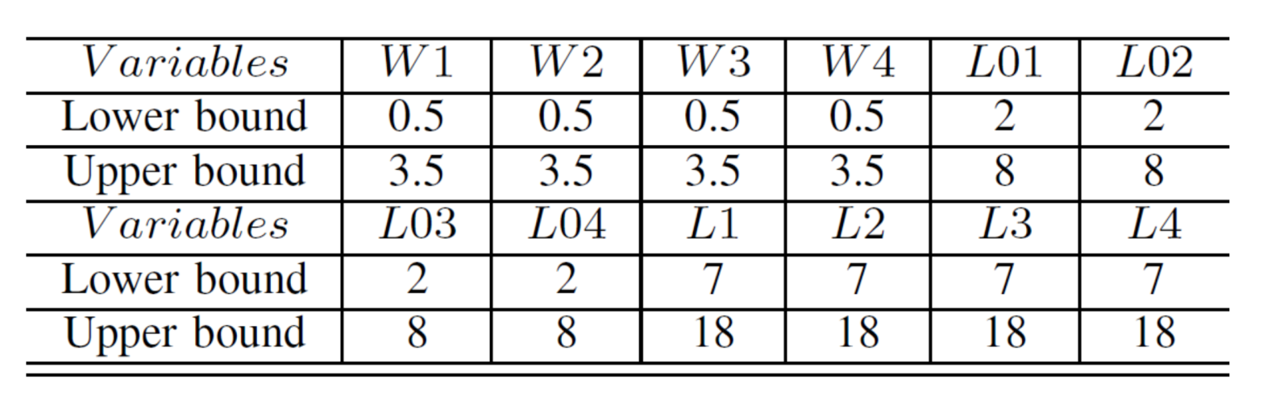
Example explanation
  Step 4: Identify the search space.
  Consultant: Could you provide search ranges of your decision variables? We cannot optimize in an infinite space. There must be a search space, outside which, the optimal design is impossible to locate there.
  Designer: Here you go.

Slide 9
Example explanation
  Step 5: Identify if there is a starting point.
  Consultant: Is there a starting point? Using the starting point, the optimization may run faster because useful information is provided.
  Designer: Yes, we do have one. This was obtained by equivalent circuits. Here it is.
  Consultant: OK. Now, the optimization problem is set.

Slide 10
Example explanation
  Step 6: Identify how to obtain the objective and constraint functions values.
  Consultant: Before optimizing it to meet your requirements, we need to know the way to obtain the objective and constraint function values for each candidate design. How did you do it?
  Designer: The objective and constraint function values are extracted from the S-parameters. They are obtained by electromagnetic simulations.
  Consultant: So, it is a simulation-based optimization problem. We will link your simulation tool and find an appropriate optimization algorithm.

Slide 11
Example explanation
After Step 6:
  Modeling an engineering problem by computer program.
    You may need MATLAB Toolboxes (e.g., signal processing toolbox, RF toolbox, etc) for simulation or other simulations tools (e.g., SPICE tools).
    Program the objective function and constraints by extracting them from the simulation result.
  Select an optimization algorithm, set it and run it.
  Analyze the optimization outcome.

Slide 12

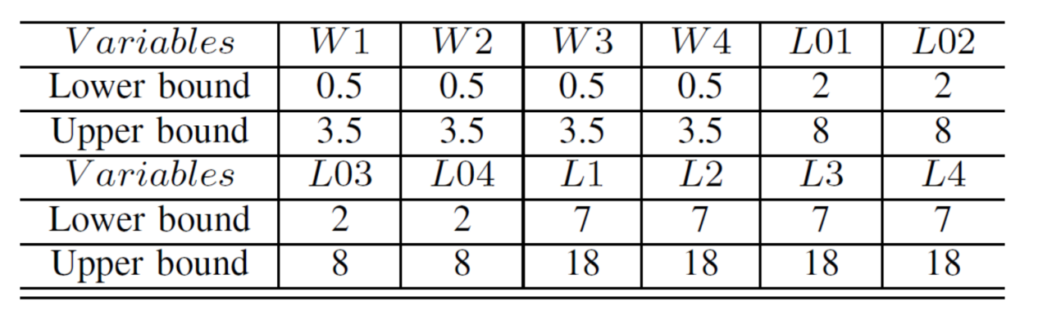
Example explanation
At the end:
“O” is too low

Slide 13
Example explanation
At the end:

Slide 14
Example explanation
At the end:
initial design performance optimal design performance

Slide 15




Thanks!
#UofGWorldChangers
@UofGlasgow

